Slide 1
Archive
July 2026
Kay Kasemir

Slide 2
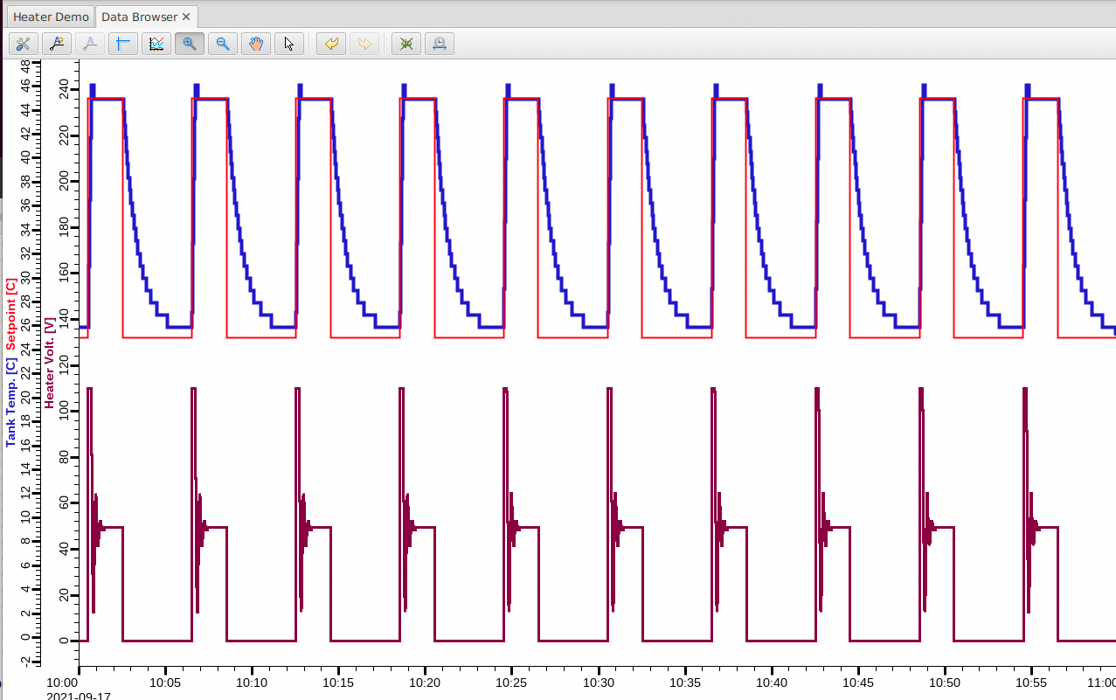
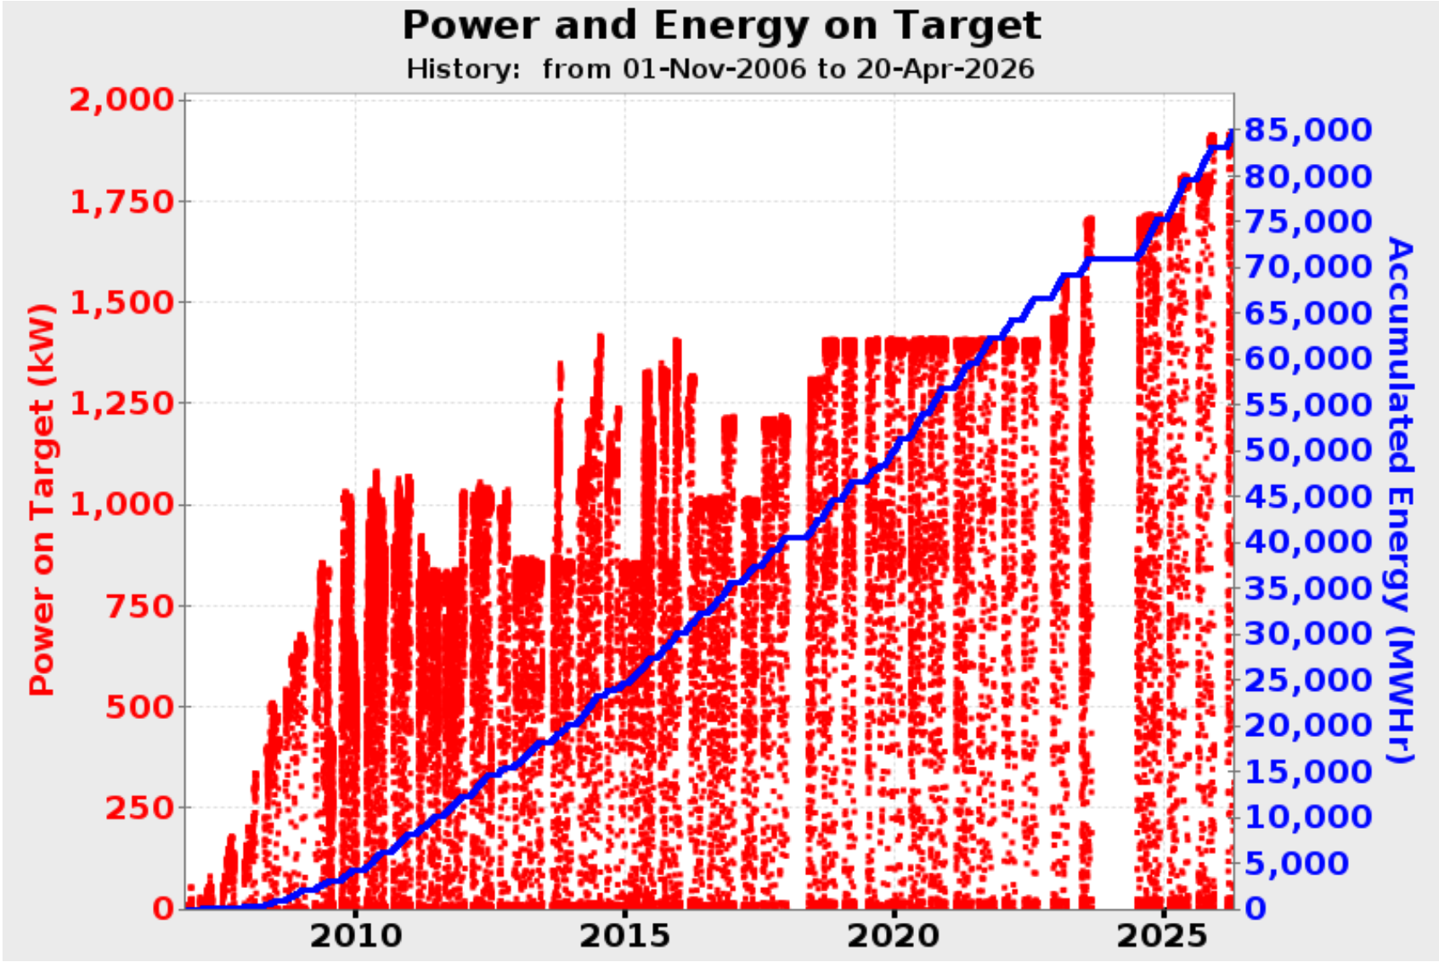
End-User View of Archive
Databrowser can show history
  Easy, “Scroll back” on time axis
May access history from Python, Java, … to perform your own analysis
  Write a program to do that

Slide 3
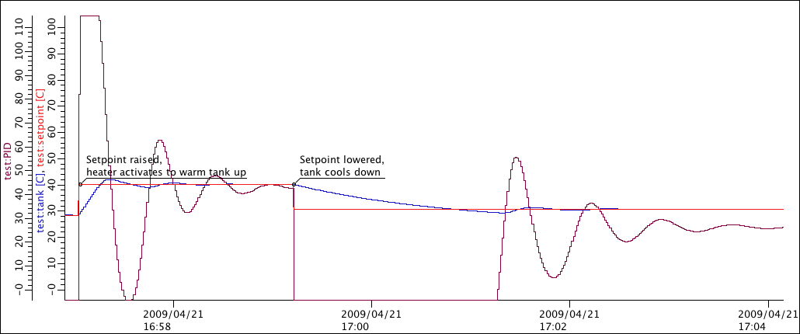
Basic Technical View of Archive
Archiver
  Reads PVs via Channel- or PVAccess
  Writes samples to Storage
  Provides history from Storage
Archiver
Storage
IOC
CA Server
PVA Server

Slide 4
More Detail
Configuration:
Which channels?
How?
Storage
Theory:
Tons of fast storage
Practice:
Slow,
limited
space
Archive Engine (Service)
Read PVs,
write samples to storage
CA, PVA
IOC

Slide 5


Choices…
 | Channel Archiver | Relational Database | TimescaleDB | EPICS Archiver Applicance
Storage | Custom “data” and “index” files | MySQL, Postgres, Oracle | Postgres optimized for time series | Custom
Storage Speed | Fast | Slow | Better than Slow | Fast
Storage Maintainability | Eventually impossible | Trivial (for RDB admin) | Trivial (for RDB admin) | A few files per channel
Configuration | XML file | RDB with XML file import/export | RDB with XML file import/export | Web interface, XML file import/export
Readout | DataBrowser, custom C++ lib | DataBrowser, any RDB client | DataBrowser, any RDB client | DataBrowser, web interface, web service

Slide 6
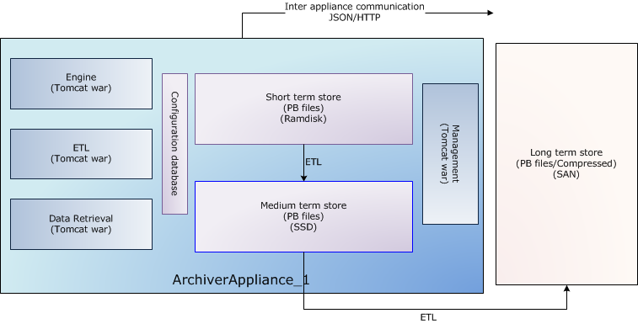
Archiver Appliance Detail
Storage: Files with “Protobuf”-encoded samples
  One file per Channel and Stage
Example Stages:
  RAM disk for ”today”
  Solid-state disk for “this month”
  NFS-mounted folder for “older”
May create cluster of applicances
Web interface to add channels, monitor performance, fetch data
See https://epicsarchiver.readthedocs.io/en/stable for “Quickstart” and more

Slide 7
Relational Database Detail
Storage: MySQL, Postgres, Oracle
  Ideal if you can leverage existing RDB cluster and admin support
  RDBs have been reliable for decades
Archive Engine, run as Linux service, writes samples to RDB
  May run one for “Vacuum”, one for “Cryogenics”, one for “Beamlines” etc.
Data accessible by Data Browser and pretty much any programming language
See https://github.com/ControlSystemStudio/phoebus/blob/master/services/archive-engine/doc/index.rst

Slide 8
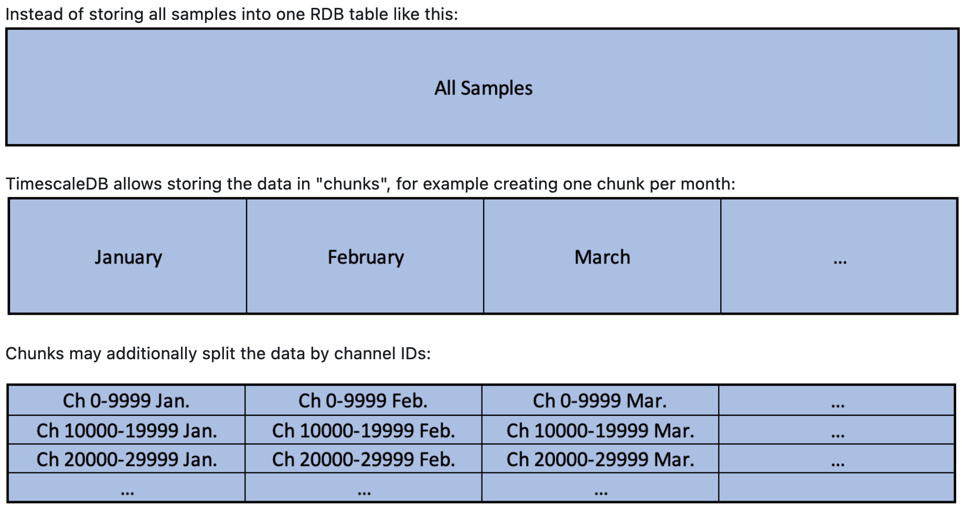
TimescaleDB Detail
RDB Admins may develop
site-specific ways to “partition”
the data and provide
stored procedures for optimized
data readout
TimescaleDB = Postgres with
extensions to automatically partition
time series data
https://github.com/ControlSystemStudio/phoebus/blob/master/app/databrowser-timescale/README.md

Slide 9
Decisions…
Archiver appliance
  Safe option, used by many in EPICS community
  You’ll need somebody to maintain the data
RDB
  Very dependable, ideal if you already have RDB admin support and want to access the data in various ways
TimescaleDB
  New, no operational experience
  Promising option for new RDB setup, headstart over site-specific partitioning solutions

Slide 10
IOC Configuration
Archive engines subscribe to “archive” aka “log” events (DBE_ARCHIVE)
  camonitor –m l the_pv_name
For analog records, configure the ADEL field*
  Unfortunately, not perfect for data with logarithmic behavior like vacuum pressures.
Assert that your IOC knows the time
  Check time stamps reported by camonitor
* Also: EGU, PREC, ZNAM, ONAM, …
If it’s worth archiving, it should be properly configured.

Slide 11
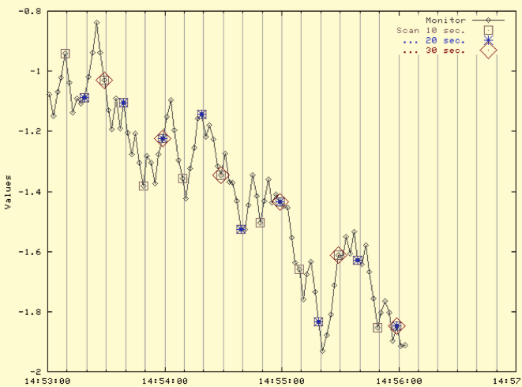
Archive Engine Options
Monitor
  Tries to save every received update
  Based on ADEL
  Might need an
  expected-update-period
  to allocate buffers,
  skipping samples if there are too many
Scan
  Writes the most recent value
  every N seconds
  Stores original time stamps

Slide 12
Viewing Archived Data
Open Data Browser, add PV, zoom/pan/set time range
Relies on Data Browser Preferences:
org.csstudio.trends.databrowser3/urls=jdbc:mysql://localhost/archive|RDB
org.csstudio.trends.databrowser3/archives=jdbc:mysql://localhost/archive|RDB
org.csstudio.trends.databrowser3/use_default_archives=true﻿
org.phoebus.archive.reader.rdb/user=report
org.phoebus.archive.reader.rdb/password=$report

Slide 13
Archive
Fundamentally simple: Store values of PVs
There is no perfect implementation
  Can’t store everything at high rate forever
On IOC side, configure ADEL (and EGU, PREC, ZNAM, ONAM)
Looking at data in Data Browser is easy

Slide 14
RDB example in training setup

Slide 15
Initial RDB Archive Installation
See https://github.com/ControlSystemStudio/phoebus/blob/master/services/archive-engine/doc/index.rst
Install MySQL or MariaDB, PostgreSQL, Oracle
Setup archive tables
Check that this happened:
sudo systemctl start mariadb.service
sudo systemctl status mariadb.service
archive-engine -list

Slide 16
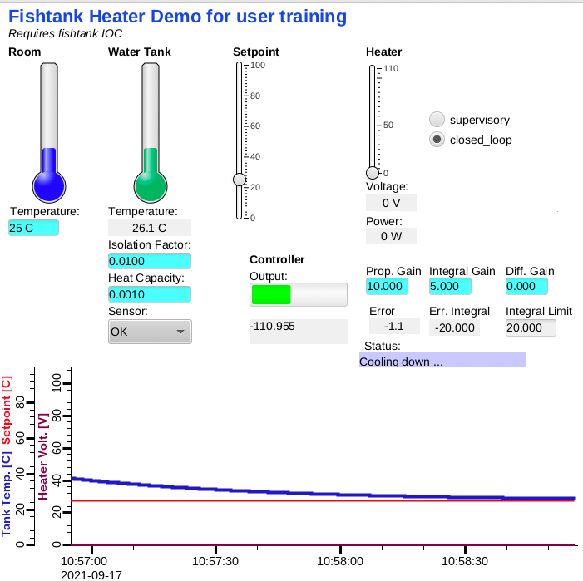
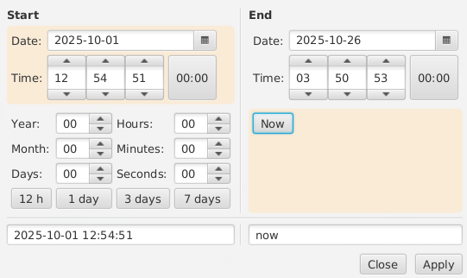
Fishtank Example
Run IOC
  cd /ics/examples/fishtank
  ./st.cmd
In CS-Studio, open /ics/examples/fishtank/heater.bob ➔ Current data
Right-click on plot, “Open Data Browser”
  Right-click to Show Toolbar
  Change time range ➔ Archived data!

Slide 17
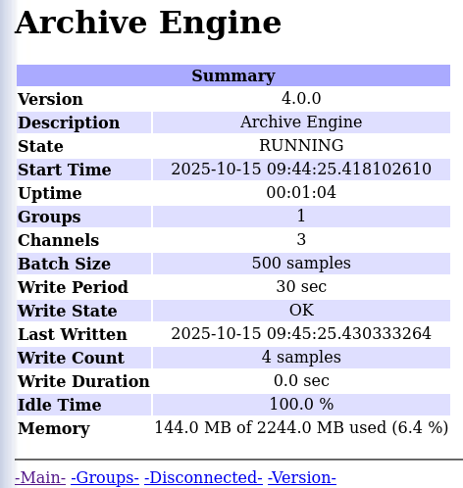
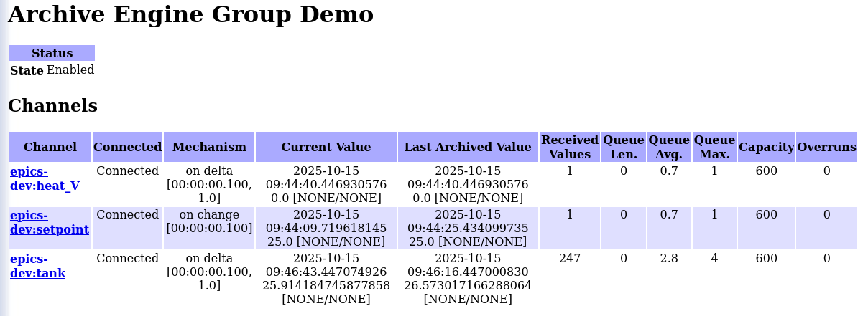
Example archive for ‘fishtank’
cd /ics/examples/14_archive/
archive-engine -help
archive-engine –list
cat fishtank.xml
Import configuration and start sample engine:
archive-engine -engine fishtank -import `pwd`/fishtank.xml -replace_engine
archive-engine -engine fishtank
Check http://localhost:4812
in web browser
lynx –dump http://localhost:4812/main
lynx –dump http://localhost:4812/stop

Slide 18
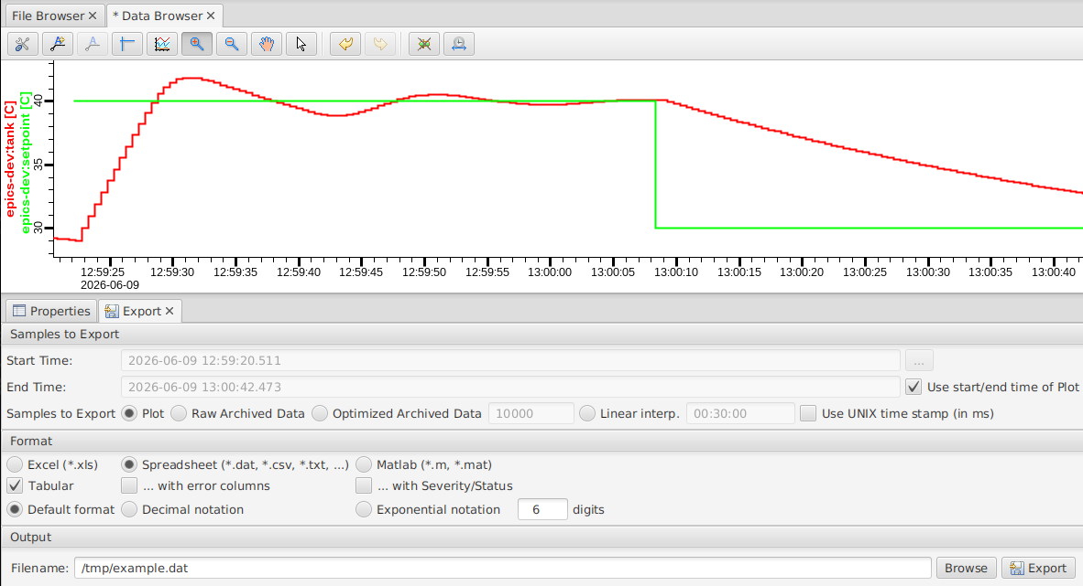
If there is no archive setup: Data Browser
Run data browser as usual
Export “Plot” data
File looks just like data exported from archive
.. Workaround to capture a few hours of data, maybe over night

Slide 19
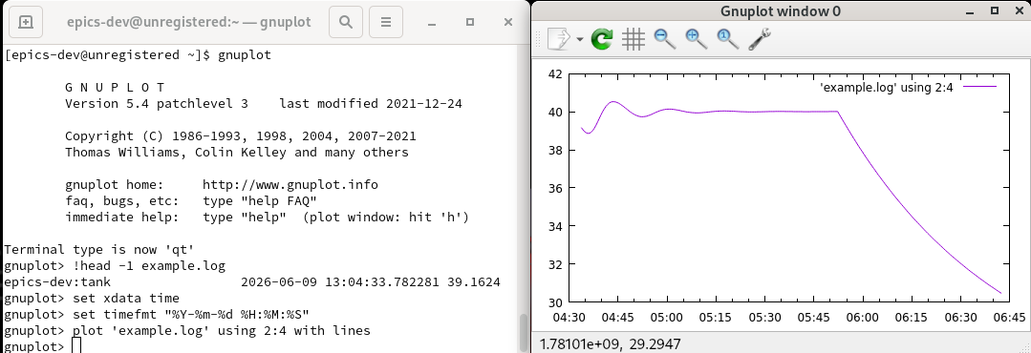
If there is no archive setup: camonitor
Capture output of camonitor
$ camonitor epics-dev:tank | tee example.log
epics-dev:tank 2026-06-09 13:04:33.782281 39.1624
epics-dev:tank 2026-06-09 13:04:34.282304 39.0474
…
Show with for example Gnuplot. (sudo dnf install gnuplot)

